Slide 1
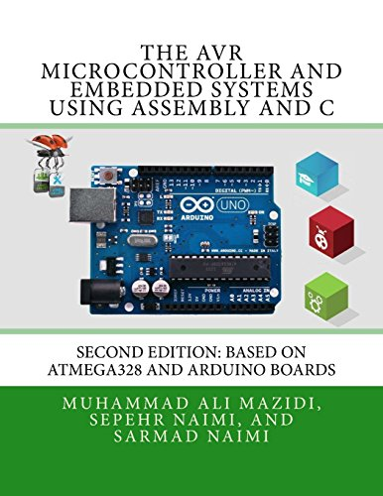

Lecture # 06M:
Assembly Language Programming for ATmega328P

Slide 2
Outline
Arduino AVR Architecture
Assembly Language Programming
Examples of Assembly Programming
Flow Chart Drawing and Algorithm Development

Slide 3
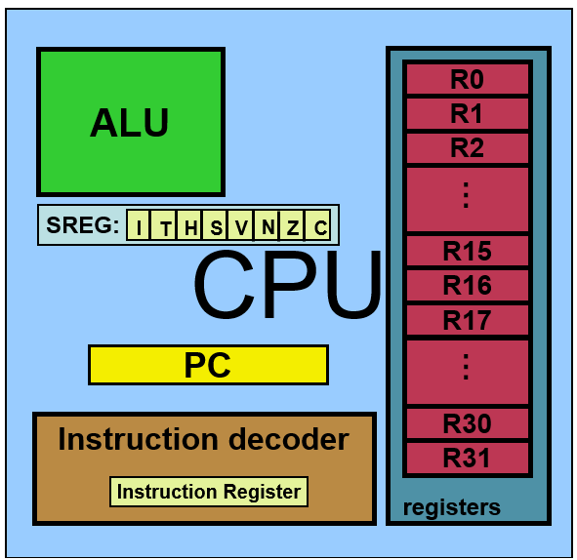
AVR Architecture of CPU
Arithmetic Logic Unit (ALU)
32 General Purpose Register (GPR) ← each 8-bit
Program Counter (PC)
Instruction Decoder
Status Register (SREG)

Slide 4
Status Register
AVR Flags/Status Register
C = Carry Flag, This flag is set whenever there is a carry out from the D7 bit after an arithmetic operation(Addition, subtraction, increment, decrement, etc.). This flag bit is affected after an 8-bit addition or substruction.
Z = Zero Flag, This flag is affected after an arithmetic or logic operation. If the result is zero than Z = 1, else Z = 0.
N = Negative Flag, It reflects the result of an arithmetic operation. If the D7 bit of the result is zero, then N = 0 and the result is positive. Else N = 1 and the result is negative.
V = Overflow Flag,
S = Sign Flag,
H = Half Carry Flag, this bit is set if there is a carry from D3 to D4 bit after ADD or SUB instruction.
T = Bit Copy Storage. Used as a temporary storage for bit. It can be used to copy a bit from a GPR to another GPR.
I = Global Interrupt Enable

Slide 5
Direct Data Register Method
DDRB Register
To assign input, put a 0
To assign output, put a 1
DDRB= 0x05;
Or DDRB= 0b00000101; PB0 and PB2 are output pins while the rest are input pins.
To write HIGH, put a logical 1
To write LOW, put a logical 0
PORTB = 0x01;
PORTB = 0b00000001; write PB0 as high.
PB7 | PB6 | PB5 | PB4 | PB3 | PB2 | PB1 | PB0
0 | 0 | 0 | 0 | 0 | 1 | 0 | 1
PORTB Register
PB7 | PB6 | PB5 | PB4 | PB3 | PB2 | PB1 | PB0
0 | 0 | 0 | 0 | 0 | 0 | 0 | 1

Slide 6
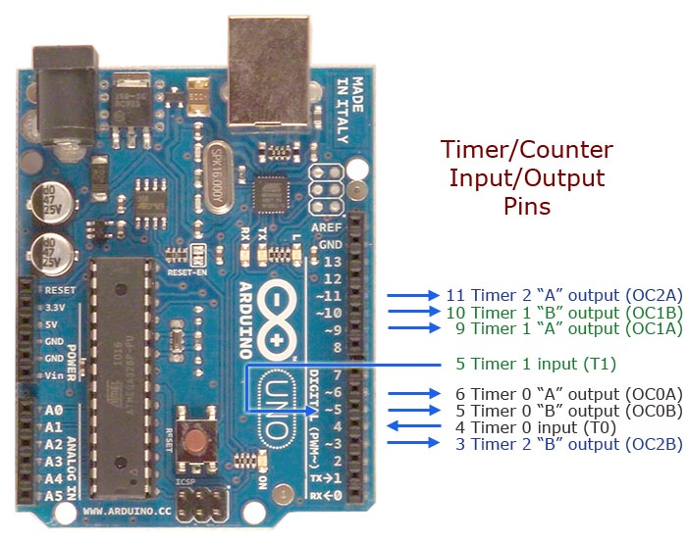
Examples of Direct Data Register Method
SBI DDRB, 3;
DDRB Register
PB7 | PB6 | PB5 | PB4 | PB3 | PB2 | PB1 | PB0
0 | 0 | 0 | 0 | 1 | 0 | 0 | 0
CBI DDRB, 5;
PB5-0
DDRB Register
PB7 | PB6 | PB5 | PB4 | PB3 | PB2 | PB1 | PB0
0 | 0 | 0 | 0 | 0 | 0 | 0 | 0
PD7-0

Slide 7
Instruction Set Summary
Arithmetic Instruction Set
Mnemonic | Operand | Description | Operations | Flag | Clock
ADD | Rd, Rr | Add two Registers | Rd ← Rd + Rr | Z,C,N,V,H | 1
ADC | Rd, Rr | Add with Carry two Registers | Rd ← Rd + Rr + C | Z,C,N,V,H | 1
ADIW | Rdl, K | Add Immediate to Word | Rdh:Rdl ← Rdh:Rdl + K | Z,C,N,V,S | 2
SUB | Rd, Rr | Subtract two Registers | Rd ← Rd - Rr | Z,C,N,V,H | 1
SBC | Rd, Rr | Subtract two Registers with Carry | Rd ← Rd - Rr - C | Z,C,N,V,H | 1
SUBI | Rd, K | Subtract Constant from Register | Rd ← Rd - K | Z,C,N,V,H | 1
SBIW | Rdl, K | Subtract Immediate from Word | Rdh:Rdl ← Rdh:Rdl - K | Z,C,N,V,S | 2
MUL | Rd, Rr | Multiply Unsigned | R1:R0 ← Rd x Rr | Z,C | 2
MULS | Rd, Rr | Multiply Signed | R1:R0 ← Rd x Rr | Z,C | 2
INC | Rd | Increment | Rd ← Rd + 1 | Z,N,V | 1
DEC | Rd | Decrement | Rd ← Rd - 1 | Z,N,V | 1

Slide 8
Instruction Set Summary
Logical Instruction Set
Mnemonic | Operand | Description | Operations | Flag | Clock
AND | Rd, Rr | Logical AND Registers | Rd ← Rd • Rr | Z,N,V | 1
ANDI | Rd, K | Logical AND Register and Constant | Rd ← Rd • K | Z,N,V | 1
OR | Rd, Rr | Logical OR Registers | Rd ← Rd V Rr | Z,N,V | 1
ORI | Rd, K | Logical OR Register and Constant | Rd ← Rd V K | Z,N,V | 1
EOR | Rd, Rr | Logical Exclusive OR Registers | Rd ← Rd ⊕ Rr | Z,N,V | 1
COM | Rd | One’s Complement | Rd ← 0xFF - Rd | Z,C,N,V | 1
NEG | Rd | Two’s Complement | Rd ← 0x00 - Rd | Z,C,N,V,H | 1
TST | Rd | Test for Zero or Minus | Rd ← Rd • Rd | Z,N,V | 1
CLR | Rd | Clear Register | Rd ← Rd ⊕ Rd | Z,N,V | 1

Slide 9
Instruction Set Summary
Data Moving Instruction Set
Mnemonic | Operand | Description | Operations | Flag | Clock
MOV | Rd, Rr | Move Between Registers | Rd ← Rr | None | 1
LDI | Rd, K | Load Immediate | Rd ← K | None | 1
LDS | Rd, K | Load Direct from data space location K | Rd← [K] | None | 1
STS | K, Rr | Store Rr to data space location K. | [K] ← Rr | None | 1
IN | Rd, P | From In Port P/ address to Rd register | Rd ← P | None | 1
OUT | P, Rr | From Rr register to Out Port P/ address | P ← Rr | None | 1
PUSH | Rr | Push Register on Stack | STACK ← Rr | None | 2
POP | Rd | Pop Register from Stack | Rd ← STACK | None | 2

Slide 10
Instruction Set Summary
Data Set Instruction Set
Mnemonic | Operand | Description | Operations | Flag | Clock
SBI | A, b | Sets a specified bit in an I/O Register | Sets the b no. bits of the A register | None | 1
CBI | A, b | Resets a specified bit in an I/O Register | Resets the b no bits of the A register | None | 1
SBIC | A, b | Skip if Bit in I/O Register is Cleared/ Reset | If b no bit of A register is 0, then skip PC by 2 or 3. | None | 1
SBIS | A, b | Skip if Bit in I/O Register is set | If b no bit of A register is 1, then skip PC by 2 or 3. | None | 1
RJUMP | K | Relative jump | PC← PC+K+1 | None | 1
NOP |  | No Operation | None | 1
BREAK |  | Break | For On-chip Debug Only | None | N/A

Slide 11
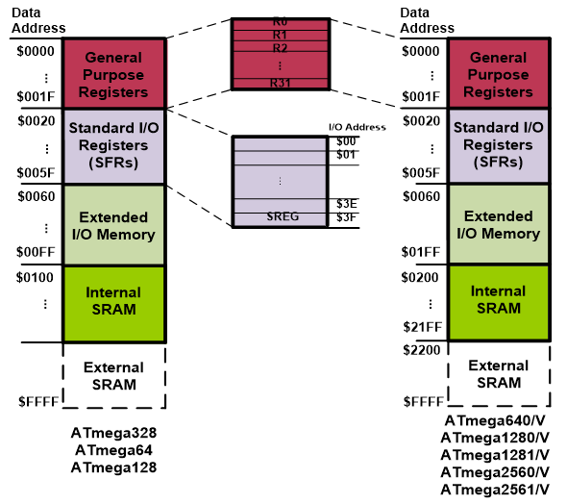
Memory Locations
STS 0x0060, R0
LDS R31, 0x01FF

Slide 12
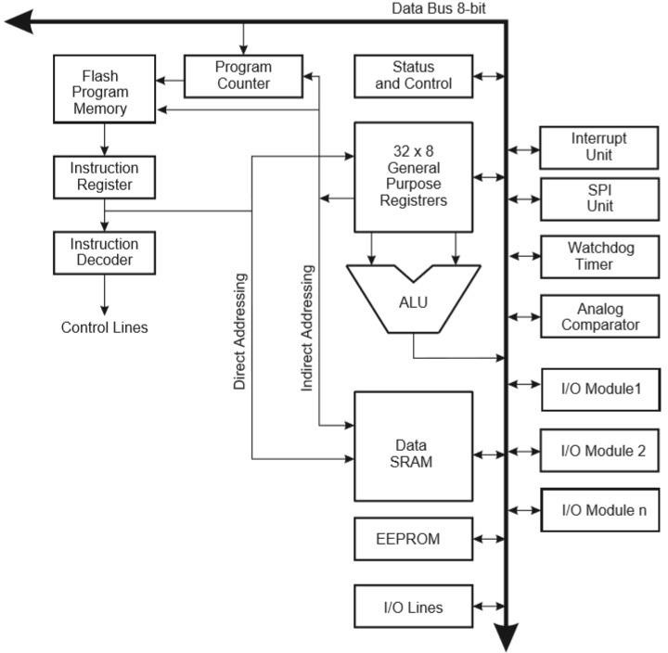
Register Contents
SBIC R7, 5;
R7 Register
8 | 7 | 6 | 5 | 4 | 3 | 2 | 1
1 | 1 | 1 | 0 | 1 | 1 | 1 | 1
PC = PC+2 or 3
SBIS R8, 5;
R8 Register
8 | 7 | 6 | 5 | 4 | 3 | 2 | 1
1 | 1 | 1 | 1 | 1 | 1 | 1 | 1
PC = PC+2 or 3

Slide 13
Programming Examples
Example: State the contents of R20, R21, and the data memory location of 0x0220 after executing the following program.
Example: State the contents of RAM locations of $0212, $0213, $0214, $0215, and $0216 after executing the following program.
LDI R20, 5;
LDI R21, 2;
ADD R20,R21;
ADD R20,R21;
STS 0x0220, R20;
Solution:
LDI R20, 5; R20=5
LDI R21, 2; R21=2
ADD R20, R21; R20=5+2=7
ADD R20, R21; R20= 7+2=9
STS 0x0220, R20; 0x0220 = 9
R20= 9
R21= 2
0x0220= 9
LDI R16, 0x99
STS 0x0212, R16
LDI R16, 0x85
STS 0x0213, R16
LDI R16, 0x3F
STS 0x0214, R16
LDI R16, 0x63
STS 0x0215, R16
LDI R16, 0x12
STS 0x0216, R16
Solution:
0x0212 | 0x99
0x0213 | 0x85
0x0214 | 0x3F
0x0215 | 0x63
0x0216 | 0x12

Slide 14
Difference Between Assembly and C
Assembly Code Example
sei; set Global Interrupt Enable sleep; enter sleep, waiting for interrupt ; note: will enter sleep before any pending interrupt(s)
C Code Example
__enable_interrupt(); /* set Global Interrupt Enable */ __sleep(); /* enter sleep, waiting for interrupt */ /* note: will enter sleep before any pending interrupt(s) */

Slide 15
EEPROM Control Register (EECR)
7 | 6 | 5 | 4 | 3 | 2 | 1 | 0
 |  | EEPM(1:0) |  | EERIE | EEMPE | EEPE | EERE
SBIC EECR, EEPE; If the EEPE bit of EECR is 0, then the Program Counter (PC) will skip 2 or 3 steps.
BIT4:5: EEPM[1:0] EEPROM Programming Mode Bits: The EEPROM programming mode selects a programming action that is executed when EEWE is set.
EERIE EEPROM Ready Interrupt Enable: Writing EERIE to '1' enables the EEPROM ready interrupt if the I bit in SREG is set.
EEMPE EEPROM Master Write Enable: The EEMPE bit determines whether writing EEPE to '1' causes the EEPROM to be written.
EEPE EEPROM Write Enable: The EEPROM write enable signal EEPE is the write strobe to the EEPROM.
EERE EEPROM Read Enable: The EEPROM read enable signal EERE is the read strobe to the EEPROM.

Slide 16
Difference Between Assembly and C
Assembly Code Example
EEPROM_Write: ; Wait for completion of previous write SBIC EECR, EEPE RJMP EEPROM_Write ; Set up address (R18:R17) in address register OUT EEARH, R18 OUT EEARL, R17 ; Write data (R16) to Data Register OUT EEDR, R16 ; Write a logical one to EEMPE SBI EECR, EEMPE ; Start EEPROM write by setting EEPE SBI EECR, EEPE RET
C Code Example
void EEPROM_write(unsigned int uiAddress, unsigned char ucData) { /* Wait for completion of previous write */ while(EECR & (1<<EEPE)) ; /* Set up address and Data Registers */ EEAR = uiAddress; EEDR = ucData; /* Write logical one to EEMPE */ EECR |= (1<<EEMPE); /* Start eeprom write by setting EEPE */ EECR |= (1<<EEPE); }

Slide 17
The next code examples show assembly and C functions for reading the EEPROM.
The examples assume that interrupts are controlled so that no interrupts will occur during the execution of these functions.
Functions of Assembly and C
Assembly Code Example
EEPROM_Read: ; Wait for completion of previous write SBIC EECR, EEPE RJMP EEPROM_Read ; Set up address (R18:R17) in address register OUT EEARH, R18 OUT EEARL, R17 ; Start EEPROM read by writing EERE SBI EECR, EERE ; Read data from Data Register IN R16, EEDR RET
C Code Example
unsigned char EEPROM_read(unsigned int uiAddress) { /* Wait for completion of previous write */ while(EECR & (1<<EEPE)) ; /* Set up address register */ EEAR = uiAddress; /* Start eeprom read by writing EERE */ EECR |= (1<<EERE); /* Return data from Data Register */ return EEDR; }

Slide 18
Bit 0 – IVCE: Interrupt Vector Change Enable
The IVCE bit must be written to logic one to enable change of the IVSEL bit. IVCE is cleared by hardware four cycles after it is written or when IVSEL is written. Setting the IVCE bit will disable interrupts,
Functions of Assembly and C
Assembly Code Example
Move_interrupts: ; Enable change of Interrupt Vectors LDI R16, (1<<IVCE) OUT MCUCR, R16 ; Move interrupts to Boot Flash section LDI R16, (1<<IVSEL) OUT MCUCR, R16 RET
C Code Example
void Move_interrupts(void) { /* Enable change of Interrupt Vectors */ MCUCR = (1<<IVCE); /* Move interrupts to Boot Flash section */ MCUCR = (1<<IVSEL); }

Slide 19
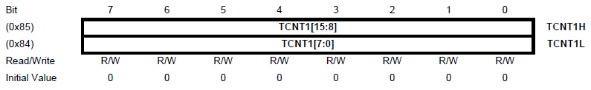
The assembly code example returns the TCNT1 value in the R17:R16 register pair.
If an interrupt occurs between the two instructions accessing the 16-bit register, the interrupt code
Updates the temporary register by accessing the same or any other of the 16-bit Timer Registers; then, the result of the access outside the interrupt will be corrupted. Therefore, when both the main code and the interrupt code update the temporary register, the main code must disable the interrupts during the 16-bit access.
Functions of Assembly and C
Assembly Code Example
; Set TCNT1 to 0x01FF LDI R17, 0X01 LDI R16, 0XFF OUT TCNT1H, R17 OUT TCNT1L, R16 ; Read TCNT1 into R17:R16 IN R16, TCNT1L IN R17, TCNT1H ...
C Code Example
unsigned int i; ... /* Set TCNT1 to 0x01FF */ TCNT1 = 0x1FF; /* Read TCNT1 into i */ i = TCNT1; ...

Slide 20
The following code examples show how to do an atomic read of the TCNT1 Register contents.
Reading any of the OCR1A/B or ICR1 Registers can be done by using the same principle
Functions of Assembly and C
Assembly Code Example
TIM16_ReadTCNT1: ; Save global interrupt flag IN R18, SREG ; Disable interrupts cli; ; Read TCNT1 into R17:R16 IN R16, TCNT1L IN R17, TCNT1H ; Restore global interrupt flag OUT SREG, R18 RET
C Code Example
unsigned int TIM16_ReadTCNT1( void ) { unsigned char sreg; unsigned int i; /* Save global interrupt flag */ sreg = SREG; /* Disable interrupts */ _CLI(); /* Read TCNT1 into i */ i = TCNT1; /* Restore global interrupt flag */ SREG = sreg; return i;

Slide 21
The assembly code example returns the TCNT1 value in the R17:R16 register pair.
The following code examples demonstrate how to perform an atomic write to the TCNT1 Register contents.
Writing any of the OCR1A/B or ICR1 Registers can be done by using the same principle
Functions of Assembly and C
Assembly Code Example
TIM16_ReadTCNT1: ; Save global interrupt flag IN R18, SREG ; Disable interrupts cli; ; Read TCNT1 into r17:r16 IN R16,TCNT1L IN R17,TCNT1H ; Restore global interrupt flag OUT SREG, R18 RET
C Code Example
unsigned int TIM16_ReadTCNT1( void ) { unsigned char sreg; unsigned int i; /* Save global interrupt flag */ sreg = SREG; /* Disable interrupts */ _CLI(); /* Read TCNT1 into i */ i = TCNT1; /* Restore global interrupt flag */ SREG = sreg; return i; }

Slide 22
The assembly code example requires that the r17:r16 register pair contains the value to be written to TCNT1.
Functions of Assembly and C
Assembly Code Example
TIM16_WriteTCNT1: ; Save global interrupt flag IN R18, SREG ; Disable interrupts cli; ; Set TCNT1 to r17:r16 OUT TCNT1H,R17 OUT TCNT1L,R16 ; Restore global interrupt flag OUT SREG, R18 RET
C Code Example
void TIM16_WriteTCNT1( unsigned int i ) { unsigned char sreg; unsigned int i; /* Save global interrupt flag */ sreg = SREG; /* Disable interrupts */ _CLI(); /* Set TCNT1 to i */ TCNT1 = i; /* Restore global interrupt flag */ SREG = sreg; }

Slide 23
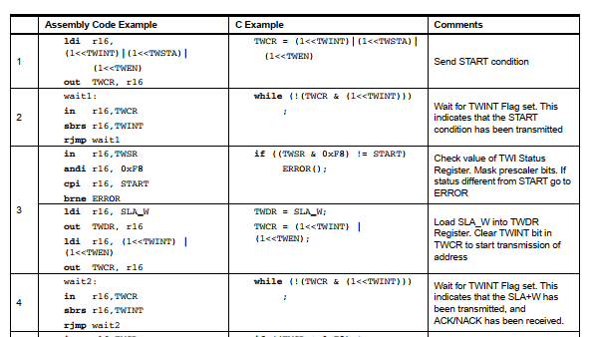
Difference Between Assembly and C

Slide 24
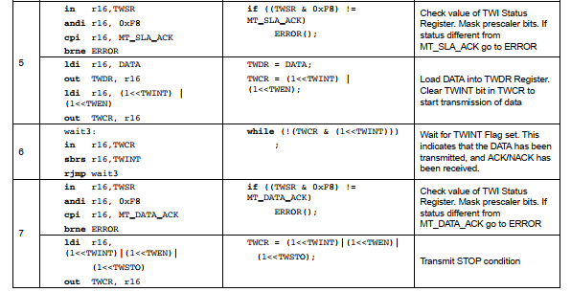
Difference Between Assembly and C

Slide 25
Determine the contents of the memory locations in binary format in Table 1 based on the following assembly language instructions:
LDI R17, 0xE6;
STS 0x21FB, R17;
LDI R22, 0xE0;
LDI R30, 0xD2;
ADD R30, R22;
STS 0x21FC, R30;
SUBI R30, 0xA1;
STS 0x21FD, R30;
AND R30, R17;
STS 0x21FE, R30;
OR R30, R17;
STS 0x21FF, R30;
Example 1 of Assembly Program
Memory Location | Contents in Binary
0x21FB
0x21FC
0x21FD
0x21FE
0x21FF

Slide 26
Answers:
LDI R17, 0xE6; // R17 register gets an immediate value of 0xE6
STS 0x21FB, R17; // Memory location, 0x21FB gets a value of 0xE6 from the register R17
LDI R22, 0xE0; // R22 register gets an immediate value of 0xE0
LDI R30, 0xD2; // R30 register gets an immediate value of 0xD2
ADD R30, R22; // R30 register gets a value of addition results of R22 and R30 registers’ contents, i.e., R30 = R30 + R22 = 0xD2 + 0xE0 = 0xB2; carry would be neglected
STS 0x21FC, R30; // Memory location, 0x21FC gets a value of 0xB2 from the register R30
SUBI R30, 0xA1; // R30 register gets a value of subtraction results of 0xA1 from R30 register’s contents, i.e., R30 = R30 – 0xA1 = 0xB2 + 0xA1 = 0x11; borrow won’t be generated
STS 0x21FD, R30; // Memory location, 0x21FD gets a value of 0x11 from the register R30
AND R30, R17; // R30 register gets a value of logical AND operation results of 0x00 from R30 register’s contents, i.e., R30 = R30 AND R17 = 0x11 AND 0xE6 = 0b00010001 AND 0b11100110 = 0x00
STS 0x21FE, R30; // Memory location, 0x21FE gets a value of 0x00 from the register R30
OR R30, R17; // R30 register gets a value of logical OR operation results of 0xE6 from R30 register’s contents, i.e., R30 = R30 OR R17 = 0x00 OR 0xE6 = 0b00000000 OR 0b11100110 = 0xE6
STS 0x21FF, R30; // Memory location, 0x21FF gets a value of 0xE6 from the register R30
Example 1 of Assembly Program

Slide 27
Example 1 of Assembly Program
Example: 0xD2 + 0xE0 = 0xB2
0b11010010
0b11100000
0b10110010 = 0xB2 [Carry, C = 1]
Example: 0x11 AND 0xE6 = 0x00
0b00010001
0b11100110
0b00000000 = 0x00
Memory Location | Contents in Binary
0x21FB | 0b11100110
0x21FC | 0b10110010
0x21FD | 0b00010001
0x21FE | 0b00000000
0x21FF | 0b11100110

Slide 28


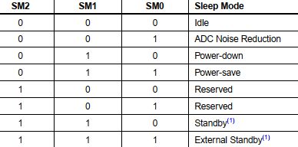
Prepare an assembly program to set the Sleep Mode Control Register (SMCR) so that the system remains in power-save mode as a whole and power reduction mode (PRR) for its PRTIM0 and PRSPI.
Example 2 of Assembly Program

Slide 29
Answers:
To set the Sleep Mode Control Register (SMCR) in the power save mode, we need to set various bits of SMCR as follows as per the bit setting of the given table (SE bit, i.e. bit 0 must be set to logical HIGH to enable the Sleep Mode):
0000 0111b = 07h
To set the Power Reduction Register (PRR) for saving the power of PRTIM0 and PRSPI, we must enable bit 5 and bit 2 of the PRR register as follows:
0010 0100b = 24h
Therefore, the assembly program should be as follows:
; Set SMCR to 0x07
LDI R16,0x07; // Sleep Mode Control Register control data is loaded into the register R16
OUT SMCR, R16; // R16 sends the control data to the SMCR to set it in power save mode
; Set PRR to 0x24
LDI R17, 0x24; // Power Reduction Register (PRR) control data is loaded into the register R17
OUT PRR, R17; // R17 sends the control data to the PRR to set it in the power reduction modes of Timer0 and SPI
Example 2 of Assembly Program

Slide 30
The word “algorithm” relates to the name of the mathematician Al-Khwarizmi, which means a procedure or a technique. A Software Engineer commonly uses an algorithm for planning and solving problems. An algorithm is a sequence of steps to solve a particular problem, or an algorithm is an ordered set of unambiguous steps that produces a result and terminates in a finite time Algorithm has the following characteristics
Input: An algorithm may or may not require input
Output: Each algorithm is expected to produce at least one result
Definiteness: Each instruction must be unambiguous.
Finiteness: If the instructions of an algorithm are executed, the algorithm should terminate after a finite number of steps
The algorithm and flowchart include the following three types of control structures.
Algorithm

Slide 31
Sequence: In the sequence structure, statements are placed one after the other, and the execution takes place starting from up to down.
Branching (Selection): In branch control, there is a condition, and according to a condition, a decision of either TRUE or FALSE is achieved. In the case of TRUE, one of the two branches is explored; but in the case of a FALSE condition, the other alternative branch is taken. Generally, the ‘IF-THEN’ is used to represent branch control.
Loop (Repetition): The Loop or Repetition allows a statement(s) to be executed repeatedly based on a certain loop condition, e.g., ‘WHILE’, ‘FOR’, ‘DO’ loops.
1. It is a step-wise representation of a solution to a given problem, which makes it easy to understand.
2. An algorithm uses a definite procedure.
3. It is not dependent on any programming language, so it is easy to understand for anyone, even without programming knowledge.
4. Every step in an algorithm has its logical sequence, so it is easy to debug.
Algorithm

Slide 32
The first design of flowchart goes back to 1945 which was designed by John Von Neumann. Unlike an algorithm, Flowchart uses different symbols to design a solution to a problem. It is another commonly used programming tool. By looking at a Flowchart, one can understand the operations and sequence of operations performed in a system.
A flowchart is often considered a blueprint of a design used for solving a specific problem.
A flowchart is a diagrammatic representation of an algorithm. Flowcharts are very helpful in writing programs and explaining programs to others.
Though, flowcharts are useful in efficient coding, debugging, and analysis of a program, drawing flowcharts for very complicated in case of complex programs is often ignored.
Flowcharts use special shapes to represent different types of actions or steps in a process.
Lines and arrows show the sequence of the steps and the relationships among them.
These are known as flowchart symbols. So, flowchart symbols are specific shapes used to create a visual representation of a program.
Flowchart

Slide 33
Advantages of Flowchart
A flowchart is an excellent way of communicating the logic of a program.
Easy and efficient to analyze the problem using a flowchart.
During the program development cycle, the flowchart plays the role of a blueprint, which makes the program development process easier.
After the successful development of a program, it needs continuous timely
maintenance during the course of its operation. The flowchart makes a program or system maintenance easier.
It is easy to convert the flowchart into any programming language code.

Slide 34
Comparison between Algorithm and Flowchart
Algorithm:
It is a procedure for solving problems.
The process is shown in step-by-step instructions in texts.
It is complex and difficult to understand.
It is convenient to debug errors
The solution is showcased in natural language.
It is somewhat easier to solve complex problem.
It costs more time to create an algorithm.
Flowchart:
It is a graphic representation of a process.
The process is shown in block-by-block information diagram with texts inside.
It is intuitive and easy to understand.
It is hard to debug errors.
The solution is showcased in pictorial form.
It is hard to solve complex problem.
It costs less time to create a flowchart.

Slide 35
While creating flowchart, the following mathematical operators are used.
Commonly used Operators in Flowchart
Operator | Meaning | Example | Remarks
+ | Addition | A + B | Values in A and B will be added
- | Subtraction | A – B | Values of B will be subtracted from that of A
* | Multiplication | A * B | Values of B will be multiplied by that of A
/ | Division | A/B | Values of A will be divided by that of B
^ | Power | A^3 | Values of A will be raised by a power of 3
% | Remainder | A%B | Values of A will be divided by that of A to get a remainder (if any)

Slide 36
While creating flowchart, the following relational operators are used.
Commonly used Operators in Flowchart
Operator | Meaning | Example | Remarks
< | Less than | A < B | Value in A is less than that of B
<= | Less than or equal to | A <= B | Value in A is less than or equal to that of B
= or == | Equal to | A = B or A == B | Values of A and B are equal
# or != | Not Equal to | A # B, A != B | Values of A and B are not equal
> | Greater than | A > B | Value in A is greater than that of B
>= | Greater than or equal to | A >= B | Value in A is greater than or equal to that of B

Slide 37
While creating flowchart, the following logical operators are used.
Commonly used Operators in Flowchart
Operator | Meaning | Example | Remarks
AND | Logical AND | A˄B | Values in A and B will be ANDed
OR | Logical OR | A˅B | Values in A and B will be ORed
NOT | Logical NOT | !A | Values in A will be inverted

Slide 38
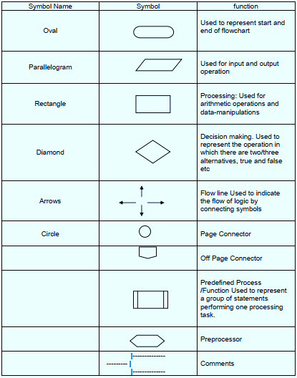
While creating a flowchart, the following symbols are used.
Commonly used Symbols in Flowchart
Rectangle Shape - Represents a process
Oval or Pill Shape - Represents the start or end
Diamond Shape - Represents a decision
Parallelogram - Represents input/output
Circle - Represents reference/page connector
Arrow - Represents a connection between shapes

Slide 39
Commonly used Symbols in Flowchart
Each symbol has its own function within the program. Each symbol represents a piece of the code written for the program. The start/end symbol can be used to represent either the beginning or ending of a program. The symbol for process allows you to show how the program is functioning, like when you need the program to calculate two numbers or even analyze the information.
When you decide to enter data, show it on the screen, or print it to paper, you use the input/output symbol. The display symbol signifies that information is displayed to the user.
There are many other symbols frequently used in flowcharts. The decision symbol is used for things like 'if statements,' where you must choose an option based on a specified criteria. A decision question may be something as simple as: if the grade is at least 70 then send out the message 'Passing' to the screen. Otherwise, send 'Failing' to the screen.

Slide 40
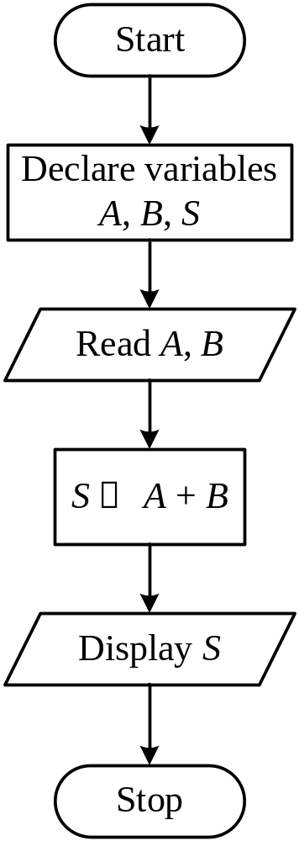
Draw a flowchart along with its algorithm to add two numbers entered by the user.
Example # 1 of Flowchart
An algorithm to find the sum of two numbers:
Step 1: Start
Step 2: Declare three variables
Step 3: Read numbers and store them in the declared variables
Step 4: Sum these two numbers and assign them to the declared variable
Step 5: Display the sum
Step 6: Stop

Slide 41
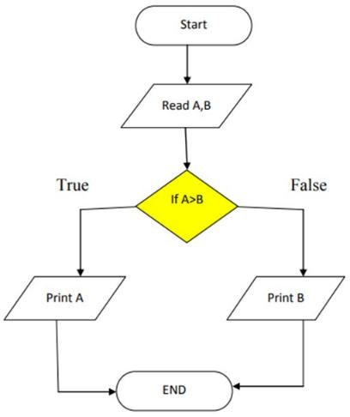
Draw a flowchart along with its algorithm to compare two numbers entered by the user and then find the greater number among the given two.
Example # 2 of Flowchart
The algorithm is given below:
Step 1: Start
Step 2: Read two numbers and store them in the two variables, A and B
Step 3: If A > B then Display A else Display B
Step 4: Stop

Slide 42
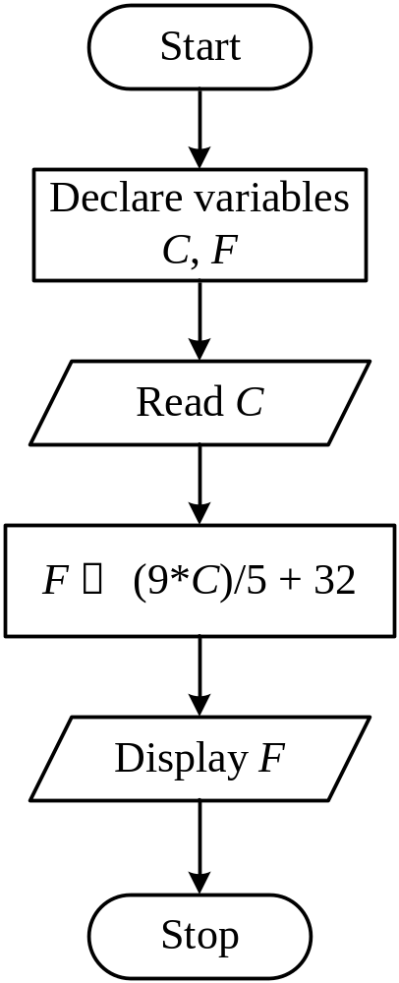
Draw a flowchart along with its algorithm to convert temperature from Celsius to Fahrenheit.
Example # 4 of Flowchart
Step 1: Start
Step 2: Declare two variables
Step 3: Read the temperature value in Celsius scale and store it in one of the declared variables
Step 4: Apply the formula of temperature conversion i.e., F = (9*C)/5 + 32 to the convert Celsius value in Fahrenheit scale and store it in the declared variable
Step 5: Display the temperature in Fahrenheit scale
Step 6: Stop

Slide 43
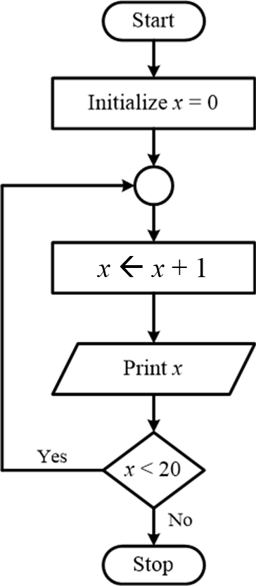
Draw a flowchart along with its algorithm to print numbers from 1 to 20.
Example # 5 of Flowchart
Step 1: Start
Step 2: Declare and initialize a variable with a 0 value
Step 3: Increment the variable value by 1 and store it in the same declared variable
Step 4: Print the value stored in the variable
Step 5: If the variable is < 20 then go to step 3, otherwise go to the next step
Step 6: Stop

Slide 44
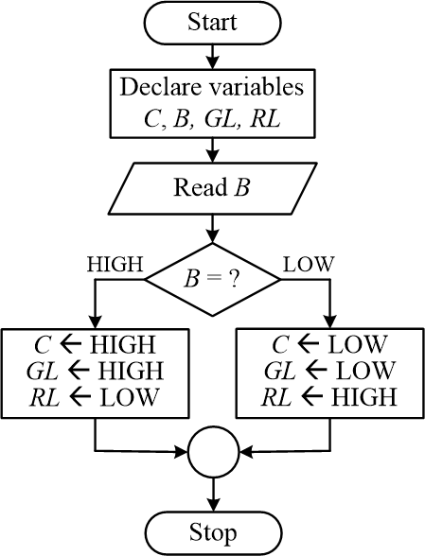
An airport has a conveyer belt to pass the luggage to the passengers. This conveyor belt (C) is operated by a push button (B) and 2 LED lights (GREEN, GL and RED, RL) are fitted in the system. If the button is pressed once, then the belt will circulate in the clockwise direction and the GREEN light will remain ON keeping the RED light OFF. If the button is not pressed then the conveyer belt will not be circulating, and the RED light will remain ON keeping the GREEN light OFF. This entire system is built around an Arduino Uno platform.
Draw a flowchart to operate the lights and conveyor belt through the switch considering the given restraints.
Practice Example # 1 of Flowchart

Slide 45
A vending machine at a university campus offers three different options for cold drinks. This machine can dispense a maximum of 3 drinks at once. The machine has a total of three buttons (button_1 for 1 drink, button_2 for 2 drinks, and button_3 for 3 drinks) to select the number of drinks to be dispensed. After this initial selection, the vending machine waits for 3 s and then displays the options for available drinks. The consumer can use the 3 buttons (button_1 for A drink, button_2 for B drink, and button_3 for C drink) to select their desired drink(s). If only 1 drink is to be dispensed, the consumer should press the relevant button, and the vending machine dispenses the chosen drink after a 3 s delay. If more than 1 drink is to be dispensed, the relevant buttons need to be pressed one after another, and the machine dispenses the drinks one at a time with a 3 s gap between the consecutive drinks. This vending machine is to be built around an Arduino Uno platform. Now, prepare a program to execute the mentioned tasks if the Arduino Uno system is operating at 16 MHz. [For this program, digital I/O pins D0 to D13 can be used.]
Practice Example # 2 of Flowchart

Slide 46
const int button1 = 2; const int button2 = 3; const int button3 = 4; const int drinkA = 8; const int drinkB = 9; const int drinkC = 10; int numDrinks = 0;
// holds selected drinks // (0=A, 1=B, 2=C) int selectedDrinks[3]; int selectionIndex = 0;
Practice Example # 2 of Flowchart
void setup() {
Serial.begin(9600);
pinMode(button1, INPUT_PULLUP);
pinMode(button2, INPUT_PULLUP);
pinMode(button3, INPUT_PULLUP);
pinMode(drinkA, OUTPUT);
pinMode(drinkB, OUTPUT);
pinMode(drinkC, OUTPUT);
// Ensure all outputs are LOW
digitalWrite(drinkA, LOW);
digitalWrite(drinkB, LOW);
digitalWrite(drinkC, LOW);
Serial.println("Vending Machine Ready...");
}
void loop() {
selectionIndex = 0;
numDrinks = 0;
Serial.println("Select number of drinks (1-3):");
// Wait for initial button press to select number of drinks
while (numDrinks == 0) {
if (digitalRead(button1) == LOW) {
numDrinks = 1;
} else if (digitalRead(button2) == LOW) {
numDrinks = 2;
} else if (digitalRead(button3) == LOW) {
numDrinks = 3;
}
delay(200); // Debounce
}

Slide 47
Serial.print("Number of drinks selected: ");
Serial.println(numDrinks); delay(3000); // Wait 3 seconds before selecting drink types
Serial.println("Select drink types:");
// Wait for drink type selections while (selectionIndex < numDrinks) { if (digitalRead(button1) == LOW) { selectedDrinks[selectionIndex++] = 0; // Drink A
Serial.println("Selected: Drink A"); delay(500); // Debounce while (digitalRead(button1) == LOW); // Wait for release
} else if (digitalRead(button2) == LOW) {
Practice Example # 2 of Flowchart
selectedDrinks[selectionIndex++] = 1; // Drink B
Serial.println("Selected: Drink B");
delay(500);
while (digitalRead(button2) == LOW);
} else if (digitalRead(button3) == LOW) {
selectedDrinks[selectionIndex++] = 2; // Drink C
Serial.println("Selected: Drink C");
delay(500);
while (digitalRead(button3) == LOW);
}
}

Slide 48
// Dispense drinks with a 3-second delay between for (int i = 0; i < numDrinks; i++) {
Serial.print("Dispensing drink "); if (selectedDrinks[i] == 0) {
Serial.println("A"); digitalWrite(drinkA, HIGH); delay(1000); // Simulate dispensing digitalWrite(drinkA, LOW);
} else if (selectedDrinks[i] == 1) {
Serial.println("B"); digitalWrite(drinkB, HIGH); delay(1000); digitalWrite(drinkB, LOW);
} else if (selectedDrinks[i] == 2) {
Practice Example # 2 of Flowchart
Serial.println("C");
digitalWrite(drinkC, HIGH);
delay(1000);
digitalWrite(drinkC, LOW);
}
if (i < numDrinks - 1) {
delay(3000); // Wait 3 seconds between drinks
}
}
Serial.println("Transaction complete.\n");
delay(3000); // Reset system after transaction
}

Slide 49
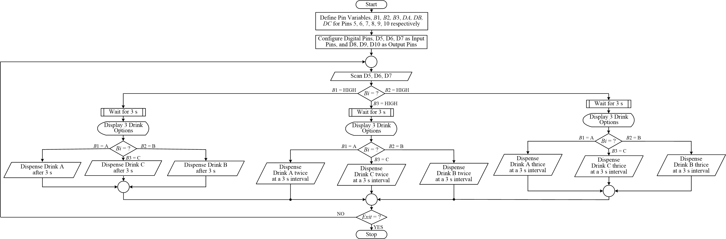
Practice Example # 2 of Flowchart

Slide 50
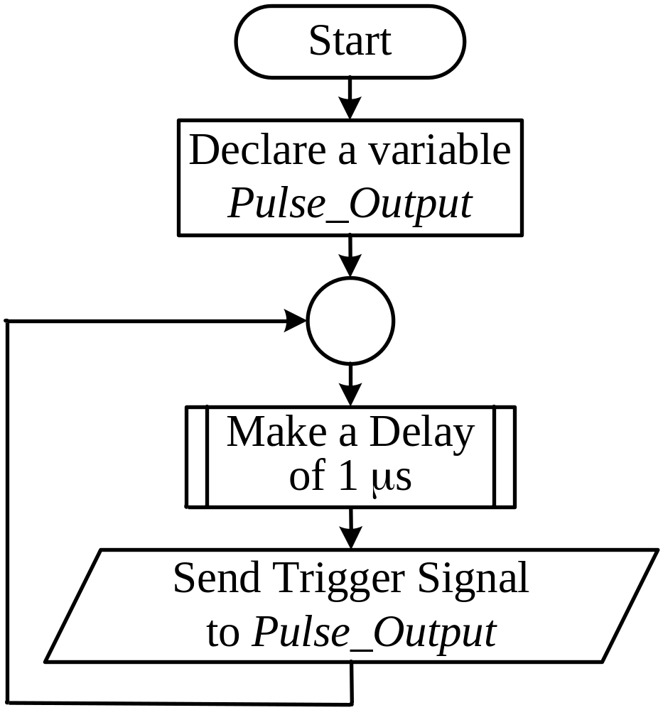
A space research facility is planning to shoot high-powered frequency pulses into space for research. These pulses are to be shot at a 1 µs interval continuously. The facility has an ATmega328P MCU to trigger every 1 µs. For this purpose, it has been decided that the predefined delay function, delay() of the Arduino IDE, will be used.
Prepare a flow chart that sends the pulses.
Practice Example # 3 of Flowchart

Slide 51
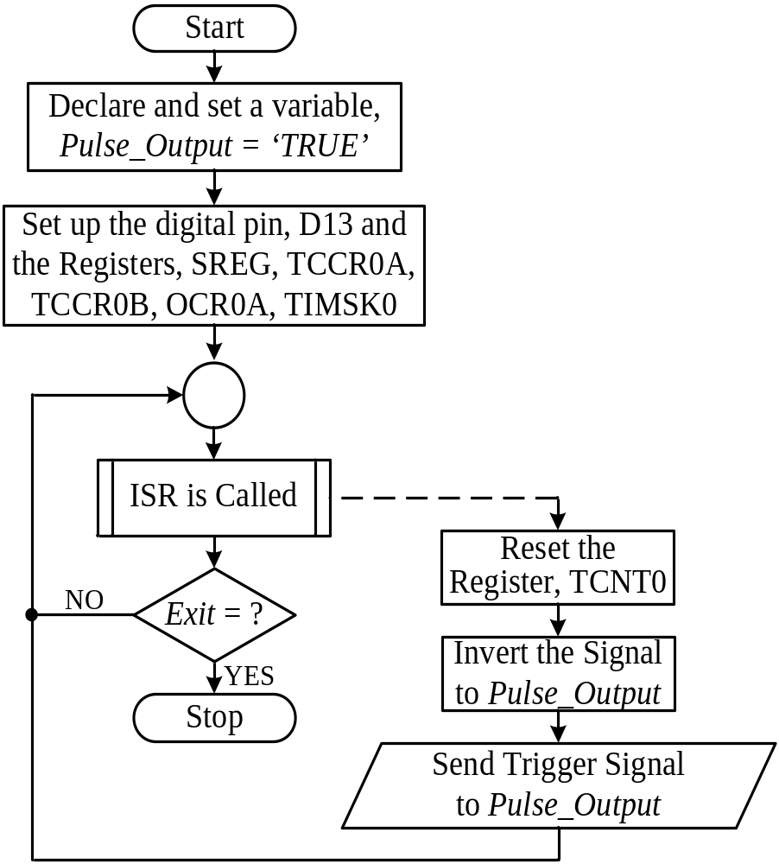
A space research facility is planning to shoot high-powered frequency pulses into space for research. These pulses are to be shot at a 1 µs interval. The facility has an ATmega328P MCU to count the time. The MCU will trigger every 1 µs, and a timer interrupt will be shot. Considering the power consumption and necessity, it is decided to use the Timer0 interrupt. The MCU runs at 16 MHz. Prepare a program to trigger the Timer0 interrupt every 1 µs. Prepare a flow chart for this purpose.
[Hint: Bits 0 to 2 of the TCCR0B register must be set. These bits correspond to the pre-scaler to be used. Output Compare Register 0A: OCR0A holds the necessary Timer0 count to achieve the required delay. Bit 1 from TIMSK0 is OCIE0A – this bit must be set to enable comparison match A. Any bits not mentioned here are to be considered as 0. All registers mentioned are 8-bit registers.]
Practice Example # 4 of Flowchart

Slide 52
Practice Example # 5 of Flowchart
A traffic control system uses 3 different colors of lights: Red, Yellow, and Green. Dhaka Metropolitan Police (DMP) wants an automated system to be implemented using a microcontroller, such as an Arduino Uno platform. Prepare a flow chart and write the code to implement this traffic control system as per the following sequences
The Red LED light will light up for 30 s.
The Red light will go off and the Green LED light will light up for 55 s.
50 s after the Green LED lights up, the Yellow LED light will start to blink for 5 s at a total 1 s interval.
[Consider blink to be a light lighting up for 500 ms and staying off for 500 ms, and the sequence is repeated.]
Then the Green LED light will turn off.
After that, the Red LED light will turn on again and the sequence will repeat continuously.

Slide 53
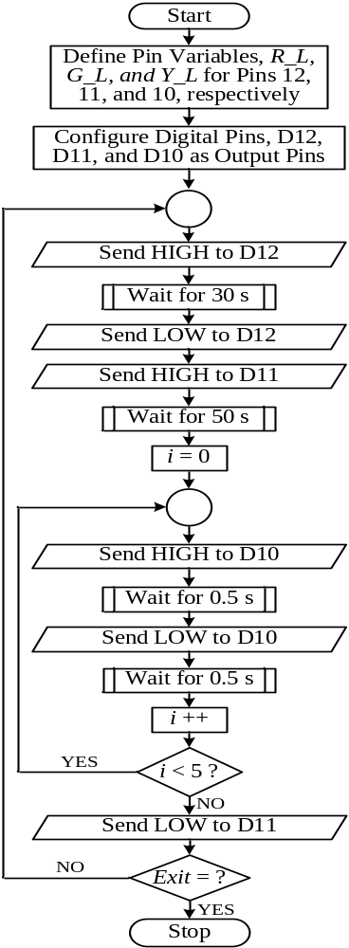
const int redPin = 12; // Pin connected to the red LED const int greenPin = 11; // Pin connected to the green LED const int yellowPin = 10; // Pin connected to the yellow LED void setup() { pinMode(redPin, OUTPUT); pinMode(yellowPin, OUTPUT); pinMode(greenPin, OUTPUT);
} void loop() {
// Red light on for 30 seconds digitalWrite(redPin, HIGH); delay(30000); //IDE’s built-in function digitalWrite(redPin, LOW);
Practice Example # 5 of Flowchart
// Green light on for 55 seconds
digitalWrite(greenPin, HIGH);
delay(50000); //IDE’s built-in function
// Yellow light blinking for 5 seconds
for (int i = 0; i < 5; i++) {
digitalWrite(yellowPin, HIGH);
delay(500); //IDE’s built-in function
digitalWrite(yellowPin, LOW);
delay(500); //IDE’s built-in function
}
digitalWrite(greenPin, LOW);
}

Slide 54
http://www.yspuniversity.ac.in/cic/algorithm-manual.pdf http://programmingposts.com/c-program-converting-celsius-fahrenheit/ https://www.edrawsoft.com/explain-algorithm-flowchart.html https://www.c-programming-simple-steps.com/flow-chart.html https://faradars.org/wp-content/uploads/2015/07/Algorithm-and-Flow-Chart.pdf
Some References on Flowchart

Slide 55

Thanks for attending….
?

